Slide 1
CST 205 OOP :Core Java Fundamentals

Slide 2
SYLLABUS
Primitive Data types - Integers, Floating Point Types, Characters, Boolean. Literals, Type Conversion and Casting, Variables, Arrays, Strings, Vector class.
Operators - Arithmetic Operators, Bitwise Operators, Relational Operators, Boolean Logical Operators, Assignment Operator, Conditional (Ternary) Operator, Operator Precedence.
Control Statements - Selection Statements, Iteration Statements and Jump Statements
Object Oriented Programming in Java - Class Fundamentals, Declaring Objects, Object Reference, Introduction to Methods, Constructors, this Keyword, Method Overloading, Using Objects as Parameters, Returning Objects, Recursion, Access Control, Static Members, Final Variables, Inner Classes, Command Line Arguments, Variable Length Arguments.
Inheritance - Super Class, Sub Class, The Keyword super, protected Members, Calling Order of Constructors, Method Overriding, the Object class, Abstract Classes and Methods, using final with Inheritance.

Slide 3
OBJECTIVES
Inheritance - Super Class, Sub Class,
The Keyword super,
protected Members,
Calling Order of Constructors,
Method Overriding, the Object class,
Abstract Classes and Methods,
using final with Inheritance.

Slide 4
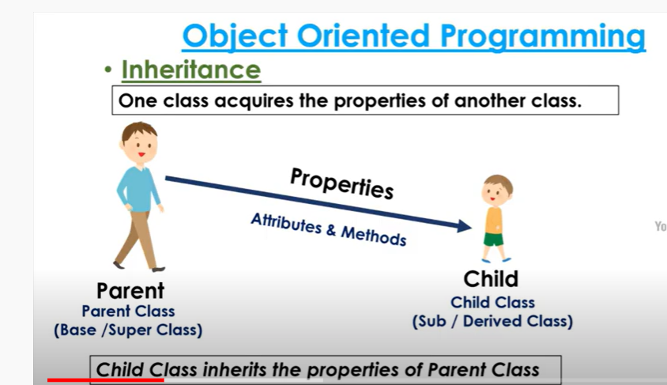

Slide 5
INHERITANCE
Inheritance is one of the cornerstones of object-oriented programming because it allows the creation of hierarchical classifications.
Using inheritance, you can create a general class that defines traits common to a set of related items. This class can then be inherited by other, more specific classes, each adding those things that are unique to it.
In the terminology of Java, a class that is inherited is called a superclass. The class that does the inheriting is called a subclass.
Therefore, a subclass is a specialized version of a superclass.
It inherits all of the instance variables and methods defined by the superclass and adds its own, unique elements..

Slide 6
Why Inheritance in java
The idea behind inheritance in Java is that you can create new classes that are built upon existing classes.
When you inherit from an existing class, you can reuse methods and fields of the parent class. Moreover, you can add new methods and fields in your current class also

Slide 7
Why use inheritance in java
For Method Overriding (so runtime polymorphism can be achieved).
For Code Reusability.

Slide 8
Class: A class is a group of objects which have common properties. It is a template or blueprint from which objects are created.
Sub Class/Child Class: Subclass is a class which inherits the other class. It is also called a derived class, extended class, or child class.
Super Class/Parent Class: Superclass is the class from where a subclass inherits the features. It is also called a base class or a parent class.
Reusability: As the name specifies, reusability is a mechanism which facilitates you to reuse the fields and methods of the existing class when you create a new class. You can use the same fields and methods already defined in the previous class.

Slide 9
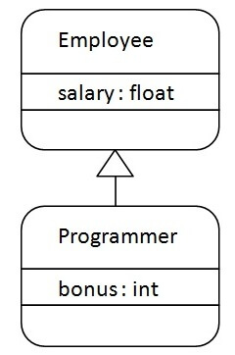
Java Inheritance Example

Slide 10
class Employee
{
float salary=40000;
}
class Programmer extends Employee
{
int bonus=10000;
public static void main(String args[])
{
Programmer p=new Programmer();
System.out.println("Programmer salary is:"+p.salary);
System.out.println("Bonus of Programmer is:"+p.bonus);
} }

Slide 11
Inheritance Basics
To inherit a class, you simply incorporate the definition of one class into another by using the extends keyword.
// Create a superclass.
class A {
int i, j;
void showij() {
System.out.println("i and j: " + i + " " + j);
}
} // Create a subclass by extending class A.
class B extends A {
int k;

Slide 12
Inheritance Basics
void showk() {
System.out.println("k: " + k);
}
void sum() {
System.out.println("i+j+k: " + (i+j+k));
}
}

Slide 13
Inheritance Basics
class SimpleInheritance {
public static void main(String args[]) {
A superOb = new A();
B subOb = new B();
// The superclass may be used by itself.
superOb.i = 10;
superOb.j = 20;
System.out.println("Contents of superOb: ");
superOb.showij();
System.out.println();

Slide 14
Inheritance Basics
/* The subclass has access to all public members of
its superclass. */
subOb.i = 7;
subOb.j = 8;
subOb.k = 9;
System.out.println("Contents of subOb: ");
subOb.showij();
subOb.showk();
System.out.println();
System.out.println("Sum of i, j and k in subOb:");
subOb.sum();
}}

Slide 15
Inheritance Basics
The output from this program is shown here:
Contents of superOb:
i and j: 10 20
Contents of subOb:
i and j: 7 8
k: 9
Sum of i, j and k in subOb:
i+j+k: 24

Slide 16
Inheritance Basics
The subclass B includes all of the members of its superclass, A.
This is why subOb can access i and j and call showij( ).
Also, inside sum( ), i and j can be referred to directly, as if they were part of B.
Even though A is a superclass for B, it is also a completely independent, stand-alone class.
The general form of a class declaration that inherits a superclass is shown here:
class subclass-name extends superclass-name {
// body of class
}

Slide 17
Member Access and Inheritance
Although a subclass includes all of the members of its superclass, it cannot access those members of the superclass that have been declared as private.
// Create a superclass.
class A {
int i; // public by default
private int j; // private to A
void setij(int x, int y) {
i = x;
j = y;
}
}

Slide 18
Member Access and Inheritance
// A's j is not accessible here.
class B extends A {
int total;
void sum() {
total = i + j; // ERROR, j is not accessible here
} }
class Access {
public static void main(String args[]) {
B subOb = new B();
subOb.setij(10, 12);
subOb.sum();
System.out.println("Total is " + subOb.total);
} }

Slide 19
Inheritance
// This program uses inheritance to extend Box. class Box { double width; double height; double depth; // constructor used when all dimensions specified Box(double w, double h, double d) { width = w; height = h; depth = d; } // constructor used when cube is created Box(double len) { width = height = depth = len; } | // compute and return volume double volume() { return width * height * depth; } } // Here, Box is extended to include weight. class BoxWeight extends Box { double weight; // weight of box // constructor for BoxWeight BoxWeight(double w, double h, double d, double m) { width = w; height = h; depth = d; weight = m; } }

Slide 20
Inheritance
class DemoBoxWeight { public static void main(String args[]) { BoxWeight mybox1 = new BoxWeight(10, 20, 15, 34.3); BoxWeight mybox2 = new BoxWeight(2, 3, 4, 0.076); double vol; vol = mybox1.volume(); System.out.println("Volume of mybox1 is " + vol); System.out.println("Weight of mybox1 is " + mybox1.weight); | System.out.println(); vol = mybox2.volume(); System.out.println("Volume of mybox2 is " + vol); System.out.println("Weight of mybox2 is " + mybox2.weight); } } The output from this program is shown here: Volume of mybox1 is 3000.0 Weight of mybox1 is 34.3 Volume of mybox2 is 24.0 Weight of mybox2 is 0.076

Slide 21
Inheritance
BoxWeight inherits all of the characteristics of Box and adds to them the weight component.
It is not necessary for BoxWeight to re-create all of the features found in Box. It can simply extend Box to meet its own purposes.
A major advantage of inheritance is that once you have created a superclass that defines the attributes common to a set of objects, it can be used to create any number of more specific subclasses.
Each subclass can precisely tailor its own classification.

Slide 22
A Superclass Variable Can Reference a Subclass Object
class RefDemo { public static void main(String args[]) { BoxWeight weightbox = new BoxWeight(3, 5, 7, 8.37); Box plainbox = new Box(); double vol; vol = weightbox.volume(); System.out.println("Volume of weightbox is " + vol); System.out.println("Weight of weightbox is " + weightbox.weight); System.out.println(); | // assign BoxWeight reference to Box reference plainbox = weightbox; vol = plainbox.volume(); // OK, volume() defined in Box System.out.println("Volume of plainbox is " + vol); /* The following statement is invalid because plainbox does not define a weight member. */ // System.out.println("Weight of plainbox is " + plainbox.weight); } }

Slide 23
A Superclass Variable Can Reference a Subclass Object
It is important to understand that it is the type of the reference variable—not the type of the object that it refers to—that determines what members can be accessed.
That is, when a reference to a subclass object is assigned to a superclass reference variable, you will have access only to those parts of the object defined by the superclass.
This is why plainbox can’t access weight even when it refers to a BoxWeight object. If you think about it, this makes sense, because the superclass has no knowledge of what a subclass adds to it.
This is why the last line of code in the preceding fragment is commented out.
It is not possible for a Box reference to access the weight field, because Box does not define one.

Slide 24
Using super keyword
In the previous example the constructor for BoxWeight explicitly initializes the width, height, and depth fields of Box( ).
Not only does this duplicate code found in its superclass, which is inefficient, but it implies that a subclass must be granted access to these members.
However, there will be times when you will want to create a superclass that keeps the details of its implementation to itself (that is, that keeps its data members private).
In this case, there would be no way for a subclass to directly access or initialize these variables on its own.
Whenever a subclass needs to refer to its immediate superclass, it can do so by use of the keyword super.

Slide 25
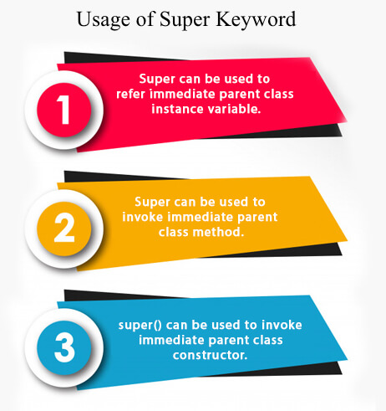

Slide 26
Uses of super keyword
Super has two general forms.
1.The first calls the superclass’ constructor.
2.The second is used to access a member of the superclass that has been hidden by a member of a subclass.
Using super to Call Superclass Constructors
A subclass can call a constructor defined by its superclass by use of the following form of super:
super(arg-list);
Here, arg-list specifies any arguments needed by the constructor in the superclass.
super( ) must always be the first statement executed inside a subclass Constructor.

Slide 27
Using super to Call Superclass Constructors
// BoxWeight now uses super to initialize its Box attributes.
class BoxWeight extends Box {
double weight; // weight of box
// initialize width, height, and depth using super()
BoxWeight(double w, double h, double d, double m) {
super(w, h, d); // call superclass constructor
weight = m;
}
}

Slide 28
Using super to Call Superclass Constructors
Here, BoxWeight( ) calls super( ) with the arguments w, h, and d. This causes the Box( ) constructor to be called, which initializes width, height, and depth using these values.
BoxWeight no longer initializes these values itself. It only needs to initialize the value unique to it: weight.
The following code in the previous program changes like shown below
class BoxWeight extends Box { double weight; // weight of box // constructor for BoxWeight BoxWeight(double w, double h, double d, double m) { width = w; height = h; depth = d; weight = m; } } | class BoxWeight extends Box { double weight; // weight of box // constructor when all parameters are specified BoxWeight(double w, double h, double d, double m) { super(w, h, d); // call superclass constructor weight = m; }

Slide 29
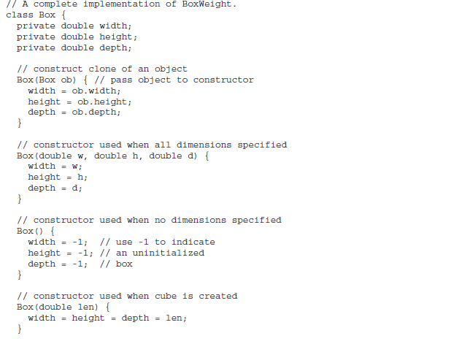
Using super to Call Superclass Constructors

Slide 30
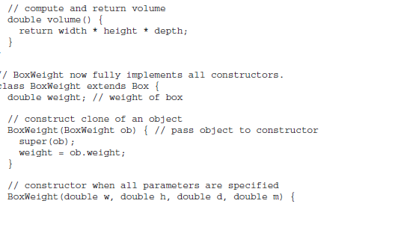
Using super to Call Superclass Constructors

Slide 31
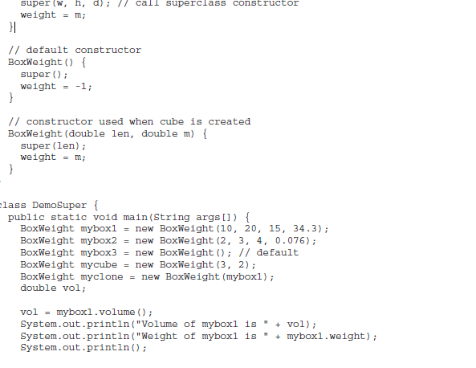
Using super to Call Superclass Constructors

Slide 32
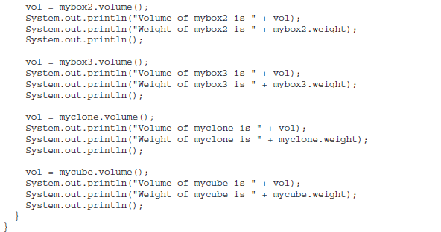
Using super to Call Superclass Constructors

Slide 33
A Second Use for super
super keyword is used to access a member of the superclass that has been hidden by a member of a subclass.
This usage has the following general form:
super.member
Here, member can be either a method or an instance variable.
// Using super to overcome name hiding.
class A {
int i;
}

Slide 34
A Second Use for super
// Create a subclass by extending class A.
class B extends A {
int i; // this i hides the i in A
B(int a, int b) {
super.i = a; // i in A
i = b; // i in B
}
void show() {
System.out.println("i in superclass: " + super.i);
System.out.println("i in subclass: " + i);
}
}

Slide 35
A Second Use for super
class UseSuper {
public static void main(String args[]) {
B subOb = new B(1, 2);
subOb.show();
}
}
This program displays the following:
i in superclass: 1
i in subclass: 2

Slide 36
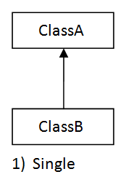
Types of inheritance in Java:
1. Single Inheritance
When a class extends another one class only then we call it a single inheritance. The below diagram shows that class B extends only one class which is A. Here A is a parent class of B and B would be a child class of A.

Slide 37
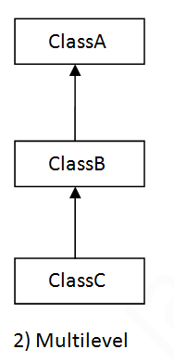
Types of inheritance in Java:
2. Multilevel Inheritance
Multilevel inheritance refers to a mechanism in technology where one can inherit from a derived class, thereby making this derived class the base class for the new class. As you can see in below diagram C is subclass or child class of B and B is a child class of A.

Slide 38
Creating a Multilevel Hierarchy
class Animal{ void eat() { System.out.println("eating...");} } class Dog extends Animal { void bark() {System.out.println("barking...");} } class BabyDog extends Dog { void weep(){System.out.println("weeping..."); } } | class TestInheritance2{ public static void main(String args[]){ BabyDog d=new BabyDog(); d.weep(); d.bark(); d.eat(); } } OUTPUT weeping... barking... eating...

Slide 39
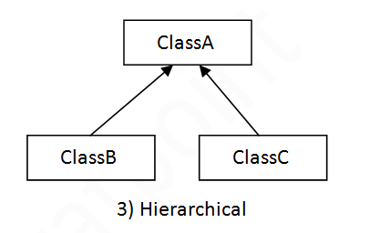
Types of inheritance in Java:
3. Hierarchical Inheritance
When two or more classes inherits a single class, it is known as hierarchical inheritance. In the example given below, Class B and Class C classes inherits the class A, so there is hierarchical inheritance.

Slide 40
HIERARCHICAL INHERITANCE
class Animal { void eat() { System.out.println("eating..."); } } class Dog extends Animal { void bark() { System.out.println("barking..."); } } class Cat extends Animal { void meow() | { System.out.println("meowing..."); } } class TestInheritance3 { public static void main(String args[]) { Cat c=new Cat(); c.meow(); c.eat(); }}

Slide 41
Why multiple inheritance is not supported in java?
When one class inherits multiple classes, it is known as multiple inheritance.
To reduce the complexity and simplify the language, multiple inheritance is not supported in java.
Consider a scenario where A, B, and C are three classes. The C class inherits A and B classes. If A and B classes have the same method and you call it from child class object, there will be ambiguity to call the method of A or B class.
Since compile-time errors are better than runtime errors, Java renders compile-time error if you inherit 2 classes. So whether you have same method or different, there will be compile time error.
class C extends A,B{//suppose if it were , Compile Time Error WILL BE GENERATED

Slide 42
Creating a Multilevel Hierarchy
We can build hierarchies that contain as many layers of inheritance as you like.\
It is perfectly acceptable to use a subclass as a superclass of another.
For example, given three classes called A, B, and C, C can be a subclass of B, which is a subclass of A.
When this type of situation occurs, each subclass inherits all of the traits found in all of its superclasses.
In this case, C inherits all aspects of B and A.

Slide 43
class student { int rollno; String name; student(int r, String n) { rollno = r; name = n; } void dispdatas() { System.out.println("Rollno = " + rollno); System.out.println("Name = " + name); } }

Slide 44
class marks extends student { int total; marks(int r, String n, int t) { super(r,n); //call super class (student) constructor total = t; } void dispdatam() { dispdatas(); // call dispdatap of student class System.out.println("Total = " + total); } }

Slide 45
class percentage extends marks { int per; percentage(int r, String n, int t, int p) { super(r,n,t); //call super class(marks) constructor per = p; } void dispdatap() { dispdatam(); // call dispdatap of marks class System.out.println("Percentage = " + per); } }

Slide 46
class Multi_Inhe { public static void main(String args[]) { percentage stu = new percentage(102689, "RATHEESH", 350, 70); //call constructor percentage stu.dispdatap(); // call dispdatap of percentage class } }

Slide 47
Output: Rollno = 102689 Name = RATHEESH Total = 350 Percentage = 70

Slide 48
When Constructors Are Called
When a class hierarchy is created, in what order are the constructors for the classes that make up the hierarchy called?
In a class hierarchy, constructors are called in order of derivation, from superclass to subclass.
Further, since super( ) must be the first statement executed in a subclass’ constructor, this order is the same whether or not super( ) is used.
If super( ) is not used, then the default or parameterless constructor of each superclass will be executed.

Slide 49
When Constructors Are Called
// Demonstrate when constructors are called. // Create a super class. class A { A() { System.out.println("Inside A's constructor."); } } // Create a subclass by extending class A. class B extends A { B() { System.out.println("Inside B's constructor."); } } // Create another subclass by extending B. class C extends B { C() { System.out.println("Inside C's constructor."); }} | class CallingCons { public static void main(String args[]) { C c = new C(); } } The output from this program is shown here: Inside A’s constructor Inside B’s constructor Inside C’s constructor

Slide 50
Method Overriding
In a class hierarchy, when a method in a subclass has the same name and type signature as a method in its superclass, then the method in the subclass is said to override the method in the superclass.
When an overridden method is called from within a subclass, it will always refer to the version of that method defined by the subclass.
The version of the method defined by the superclass will be hidden.
If you wish to access the superclass version of an overridden method, you can do so by using super.

Slide 51
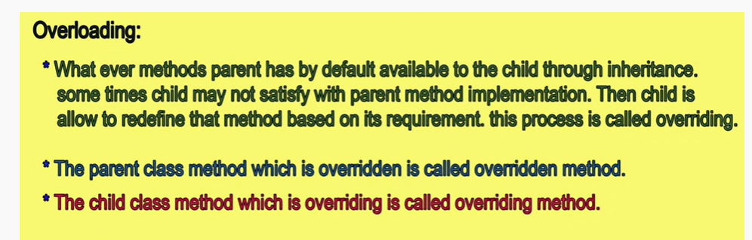

Slide 52
Method Overriding
// Method overriding. class A { int i, j; A(int a, int b) { i = a; j = b; } // display i and j void show() { System.out.println("i and j: " + i + " " + j); } } class B extends A { int k; B(int a, int b, int c) { super(a, b); k = c; } | // display k – this overrides show() in A void show() { System.out.println("k: " + k); } } class Override { public static void main(String args[]) { B subOb = new B(1, 2, 3); subOb.show(); // this calls show() in B } } The output produced by this program is shown here: k: 3

Slide 53
Method Overriding
class B extends A { int k; B(int a, int b, int c) { super(a, b); k = c; } void show() { super.show(); // this calls A's show() System.out.println("k: " + k); } } | If you substitute this version of B into the previous program, you will see the following output: i and j: 1 2 k: 3 Here, super.show( ) calls the superclass version of show( ).

Slide 54
Dynamic Method Dispatch [Run time polymorphism]
Method overriding forms the basis for one of Java’s most powerful concepts: dynamic method dispatch.
Dynamic method dispatch is the mechanism by which a call to an overridden method is resolved at run time, rather than compile time.
Dynamic method dispatch is important because this is how Java implements run-time polymorphism.
Superclass reference variable can refer to a subclass object.
Java uses this fact to resolve calls to overridden methods at run time.
When an overridden method is called through a superclass reference, Java determines which version of that method to execute based upon the type of the object being referred to at the time the call occurs.

Slide 55
Dynamic Method Dispatch [Run time polymorphism]
Thus, this determination is made at run time. When different types of objects are referred to, different versions of an overridden method will be called.
In other words, it is the type of the object being referred to (not the type of the reference variable) that determines which version of an overridden method will be executed.
Therefore, if a superclass contains a method that is overridden by a subclass, then when different types of objects are referred to through a superclass reference variable, different versions of the method are executed.

Slide 56
Dynamic Method Dispatch [Run time polymorphism]
// Dynamic Method Dispatch class A { void m1() { System.out.println("Inside A's callme method"); } } class B extends A { // override m1() void m1 () { System.out.println("Inside B's callme method"); } } class C extends A { // override m1() void m1 () { System.out.println("Inside C's callme method"); } } | class Dispatch { public static void main(String args[]) { A a = new A(); // object of type A B b = new B(); // object of type B C c = new C(); // object of type C A r; // obtain a reference of type A r = a; // r refers to an A object r. m1(); // calls A's version of callme r = b; // r refers to a B object r. m1(); // calls B's version of callme r = c; // r refers to a C object r. m1(); // calls C's version of callme }} The output from the program is shown here: Inside A’s callme method Inside B’s callme method Inside C’s callme method

Slide 57
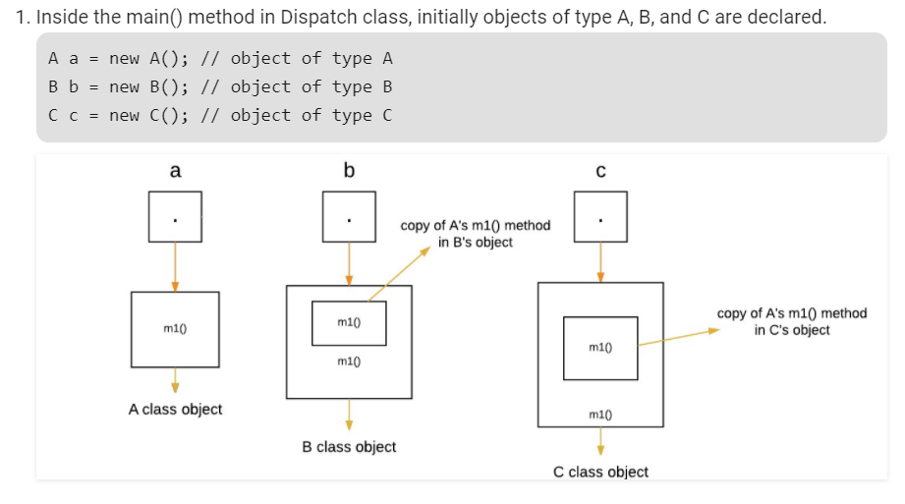
Dynamic Method Dispatch

Slide 58
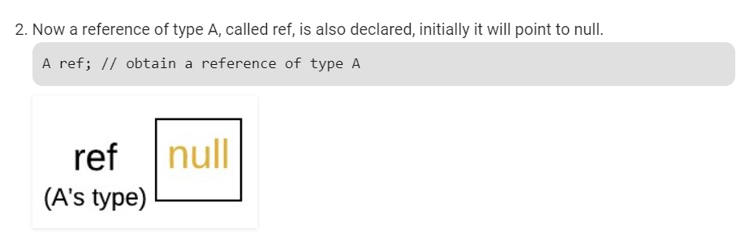
Dynamic Method Dispatch

Slide 59
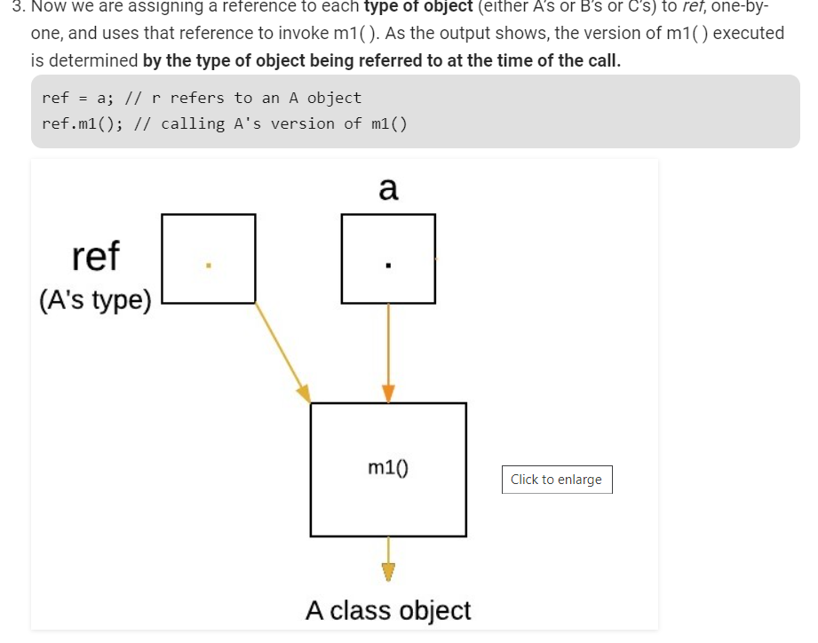
Dynamic Method Dispatch

Slide 60
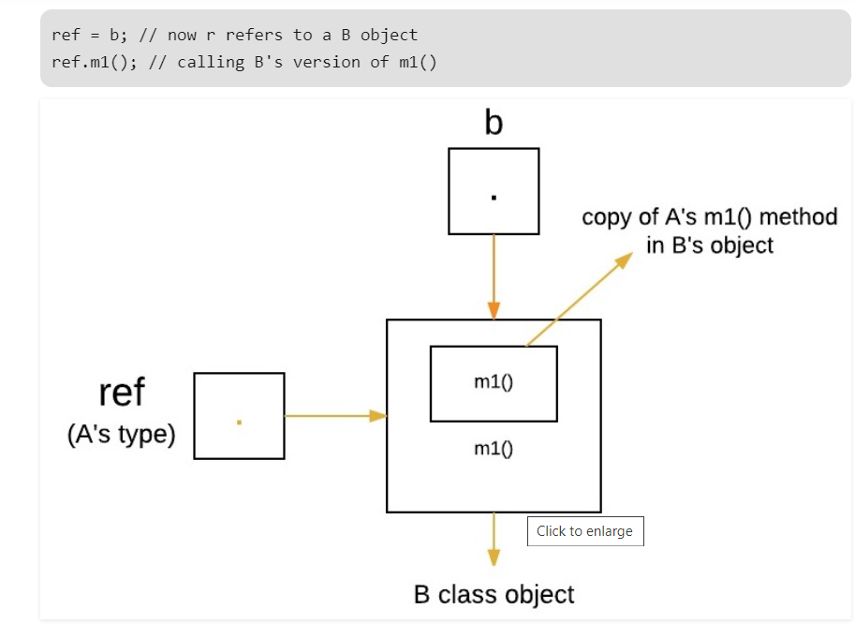
Dynamic Method Dispatch

Slide 61
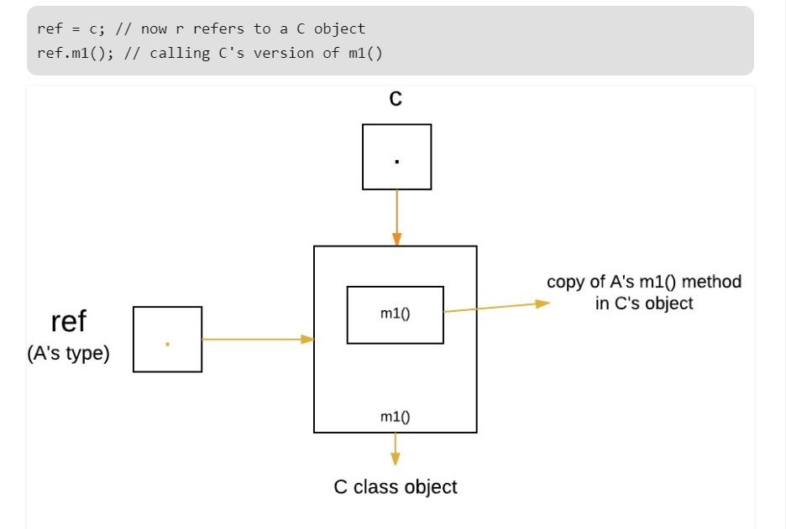
Dynamic Method Dispatch

Slide 62
ADVANTAGES OF METHOD OVERRIDING
Overridden methods allow Java to support run-time polymorphism.
Polymorphism is essential to object-oriented programming for one reason: it allows a general class to specify methods that will be common to all of its derivatives, while allowing subclasses to define the specific implementation of some or all of those methods.
Overridden methods are another way that Java implements the “one interface, multiple methods” aspect of polymorphism.
By combining inheritance with overridden methods, a superclass can define the general form of the methods that will be used by all of its subclasses.
Dynamic, run-time polymorphism is one of the most powerful mechanisms that code reuse and robustness

Slide 63
Static vs Dynamic binding
Static binding is done during compile-time while dynamic binding is done during run-time.
private, final and static methods and variables uses static binding and bonded by compiler while overridden methods are bonded during runtime based upon type of runtime object

Slide 64
Applying Method Overriding
// Using run-time polymorphism. class Figure { double dim1; double dim2; Figure(double a, double b) { dim1 = a; dim2 = b; } double area() { System.out.println("Area for Figure is undefined."); return 0; } } class Rectangle extends Figure { Rectangle(double a, double b) { super(a, b); } | // override area for rectangle double area() { System.out.println("Inside Area for Rectangle."); return dim1 * dim2; } } class Triangle extends Figure { Triangle(double a, double b) { super(a, b); } // override area for right triangle double area() { System.out.println("Inside Area for Triangle."); return dim1 * dim2 / 2; } }

Slide 65
Applying Method Overriding
class FindAreas { public static void main(String args[]) { Figure f = new Figure(10, 10); Rectangle r = new Rectangle(9, 5); Triangle t = new Triangle(10, 8); Figure figref; figref = r; System.out.println("Area is " + figref.area()); figref = t; System.out.println("Area is " + figref.area()); figref = f; System.out.println("Area is " + figref.area()); } } | The output from the program is shown here: Inside Area for Rectangle. Area is 45 Inside Area for Triangle. Area is 40 Area for Figure is undefined. Area is 0

Slide 66
UPCASTING IN JAVA
Inheritance is an important pillar of OOP(Object Oriented Programming). It is the mechanism in Java by which one class is allowed to inherit the features (fields and methods) of another class.
There are two ways in which the objects can be initialized while inheriting the properties of the parent and child classes. They are:
Child c = new Child(): The use of this initialization is to access all the members present in both parent and child classes, as we are inheriting the properties.
Parent p = new Child(): This type of initialization is used to access only the members present in the parent class and the methods which are overridden in the child class. This is because the parent class is upcasted to the child class.
What is upcasting? Upcasting is the typecasting of a child object to a parent object. Upcasting can be done implicitly. Upcasting gives us the flexibility to access the parent class members but it is not possible to access all the child class members using this feature. Instead of all the members, we can access some specified members of the child class. For instance, we can access the overridden methods.

Slide 67
Java Abstraction
Abstract Classes and Methods
Data abstraction is the process of hiding certain details and showing only essential information to the user.
Abstraction can be achieved with either abstract classes or interfaces
The abstract keyword is a non-access modifier, used for classes and methods:
Abstract class: is a restricted class that cannot be used to create objects (to access it, it must be inherited from another class).
Abstract method: can only be used in an abstract class, and it does not have a body. The body is provided by the subclass (inherited from).
An abstract class can have both abstract and regular methods.

Slide 68
Java Abstraction
Abstract Classes and Methods
abstract class Animal
{
public abstract void animalSound();
public void sleep()
{
System.out.println("Zzz");
} }
From the example above, it is not possible to create an object of the Animal class:

Slide 69
Java Abstraction
Animal myObj = new Animal(); // will generate an error
To access the abstract class, it must be inherited from another class.
// Subclass (inherit from Animal) class Pig extends Animal { public void animalSound() { / /The body of animalSound() is provided here System.out.println("The pig says: wee wee"); } } | class MyMainClass { public static void main(String[] args) { Pig myPig = new Pig(); myPig.animalSound(); myPig.sleep(); } }

Slide 70
Java Abstraction
Abstract Classes and Methods
Abstract Methods are sometimes referred to as subclasser responsibility because they have no implementation specified in the superclass.
Thus, a subclass must override them—it cannot simply use the version defined in the superclass.
To declare an abstract method, use this general form:
abstract type name(parameter-list);
Any class that contains one or more abstract methods must also be declared abstract.

Slide 71
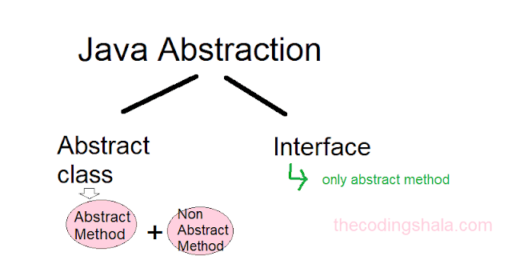
Java Abstraction

Slide 72
Java Abstraction
Abstract Classes and Methods
To declare a class abstract, you simply use the abstract keyword in front of the class keyword at the beginning of the class declaration.
There can be no objects of an abstract class. That is,an abstract class cannot be directly instantiated with the new operator.
Such objects would be useless, because an abstract class is not fully defined. Also, you cannot declare abstract constructors, or abstract static methods.
Any subclass of an abstract class must either implement all of the abstract methods in the superclass, or be itself declared abstract.

Slide 73
Java Abstraction
// A Simple demonstration of abstract. abstract class A { abstract void callme(); // concrete methods are still allowed in abstract classes void callmetoo() { System.out.println("This is a concrete method."); } } class B extends A { void callme() { System.out.println("B's implementation of callme."); } } | class AbstractDemo { public static void main(String args[]) { B b = new B(); b.callme(); b.callmetoo(); } }

Slide 74
Java Abstraction
// Using abstract methods and classes. abstract class Figure { double dim1; double dim2; Figure(double a, double b) { dim1 = a; dim2 = b; } // area is now an abstract method abstract double area(); } | class Rectangle extends Figure { Rectangle(double a, double b) { super(a, b); } // override area for rectangle double area() { System.out.println("Inside Area for Rectangle."); return dim1 * dim2; } }

Slide 75
Java Abstraction
class Triangle extends Figure { Triangle(double a, double b) { super(a, b); } // override area for right triangle double area() { System.out.println("Inside Area for Triangle."); return dim1 * dim2 / 2; } } | class AbstractAreas { public static void main(String args[]) { // Figure f = new Figure(10, 10); // illegal now Rectangle r = new Rectangle(9, 5); Triangle t = new Triangle(10, 8); Figure figref; // this is OK, no object is created figref = r; System.out.println("Area is " + figref.area()); figref = t; System.out.println("Area is " + figref.area()); } }

Slide 76
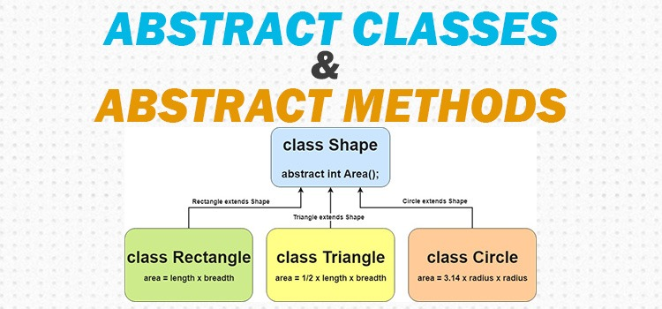
Java Abstraction

Slide 77
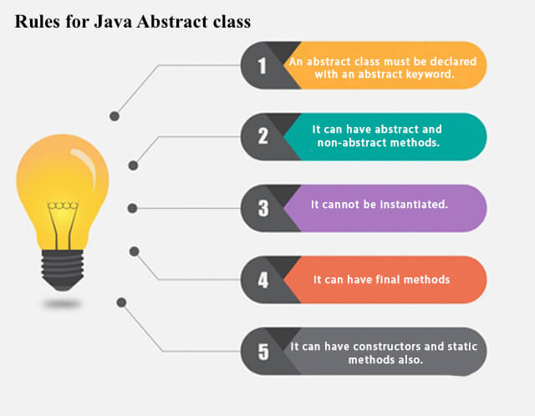
Java Abstraction

Slide 78
Java Abstract classes advantages
It helps in generalisation of its methods when class extends an Abstract class. And helps in code reusability.
Abstraction at the top level can help in writing flexible software. A key challenge while writing software (Java Programs, C++ programs) is not just to cater today's requirement but also to ensure that nurture requirement can be handled without any architectural or design change in your code. In short, your software must be flexible enough to support future changes.
Abstraction is very important to design flexible systems.
To achieve security - hide certain details and only show the important details of an object.

Slide 79
Three uses of final keyword
1.To create constants
final int FILE_NEW = 1;
final int FILE_OPEN = 2;
2. Using final to Prevent Overriding
To disallow a method from being overridden,specify final as a modifier at the start of its declaration. Methods declared as final cannot be overridden.

Slide 80
Three uses of final keyword
class A {
final void meth() {
System.out.println("This is a final method.");
}
}
class B extends A {
void meth() { // ERROR! Can't override.(compile time error)
System.out.println("Illegal!");
}
}

Slide 81
Three uses of final keyword
3.Using final to Prevent Inheritance
Sometimes you will want to prevent a class from being inherited. To do this, precede the class declaration with final.
Declaring a class as final implicitly declares all of its methods as final, too.
As you might expect, it is illegal to declare a class as both abstract and final since an abstract class is incomplete by itself and relies upon its subclasses to provide complete implementations.
final class A {
// ...
}
// The following class is illegal.
class B extends A { // ERROR! Can't subclass A
// ...}

Slide 82
SUMMARY
Inheritance is one of the cornerstones of object-oriented programming because it allows the creation of hierarchical classifications.
Using inheritance, you can create a general class that defines traits common to a set of related items.
This class can then be inherited by other, more specific classes, each adding those things that are unique to it. In the terminology of Java, a class that is inherited is called a superclass.
The class that does the inheriting is called a subclass. Therefore, a subclass is a specialized version of a superclass. It inherits all of the instance variables and methods defined by the superclass and adds its own, unique elements.

Slide 83
Thanks!
Any questions?

